Slide 1
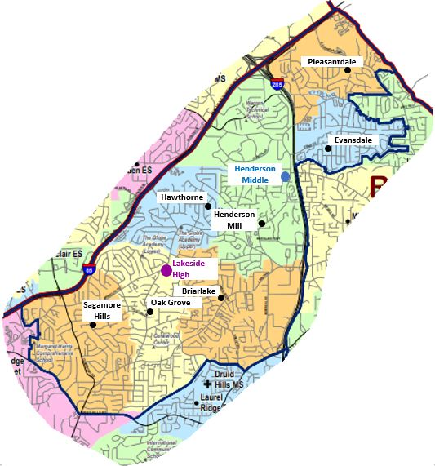
Getting Started in DeKalb Public School
Part 1: All about Enrollment and Registration
Lakeside Cluster Summit
Notes:
Welcome to this video brought to you by the Lakeside Cluster Summit. This is the group of schools that belongs to the Henderson Middle and Lakeside High School attendance area.
Today we want to explain how to get started in DeKalb Public School.
Part 1 explains enrolment and registration

Slide 2
There are 3 steps to registration:
This is for new students!
Enrollment in the DeKalb County School System
Registration at the school
Confirming registration
This is for students who change schools
This happens every year
Lakeside Cluster Summit
Notes:
There are 3 steps you take to register your child at your school.
First is enrolling your child in the DeKalb County School System.
Next is registering your child at the school they will attend
Next is confirming registration.
Enrollment is for new students, registration is for students who change schools, and confirming registration happens every year

Slide 3
So – is my child a new student who needs to enroll?
Did your child attend the same school last year?
Not new
Did your child attend the neighborhood school in your area but is switching from elementary to middle or from middle to high school?
Not new
This is called “coming from a feeder school”
Lakeside Cluster Summit
Notes:
The first question to ask is: What does “New Student” even mean?
You already guessed that your child is not new if they attended the same school. But your child is also not new if you still live in the area and your child is switching from elementary to middle or from middle to high school. This is called ‘feeder schools’ – in the Lakeside district we have 7 elementary schools that feed into Henderson Middle, and Henderson Middle feeds into Lakeside.

Slide 4
If your child is not new:
You don’t have to enroll
You don’t have to register
You do need to confirm registration
Normally: Show a proof of residence to the school at the start of the year
In 2020: Wait for instructions on when and how to submit a proof of residence
If your child is not new, you can skip to the end.
Lakeside Cluster Summit
Notes:
If your child is not new:
You don’t have to enroll, that’s done. Your child has a Student ID.
You don’t have to register; the school has your child on their list
You do have to confirm registration. This means showing a proof of residence, like a gas, water, electric bill, or lease.
In 2020, wait for instructions about when and how to show the proof of residence
If your child is not new, you can skip the rest of this video!

Slide 5
What about transferring from another DeKalb school?
If your child attended another DeKalb school last year:
Already enrolled (has Student ID)
Needs to register at the new school
Contact your old school to transfer your child’s records
Transferred in the spring? Confirm registration in the summer by providing a proof of residence
Lakeside Cluster Summit
Notes:
If your child is transferring from another DeKalb school, like if you moved, or are changing from a charter, theme, or magnet school, your child is already enrolled and has a student ID. You do need to register your child at the new school. You start by contacting your old school to transfer your child’s records. They can explain what you need to do.
If you transferred in the spring, you need to confirm registration by providing a proof of residence in the summer.

Slide 6
New to DeKalb County Public Schools:
Starting PreK or Kindergarten
Coming from a private or home school
Moving to DeKalb County
You need to enroll your child!
Lakeside Cluster Summit
Notes:
Your child is new to DeKalb County Public schools if they are starting PreK or Kindergarten, if they are coming from a private or home school, or if you moved to DeKalb County from a different school district. You need to start by enrolling your child.

Slide 7
Two ways to enroll:
If your child’s primary language is English and your child was born in the US:
Enroll your child online:
https://www.dekalbschoolsga.org/online-registration/new-students/
If your home language is not English, or your child was born outside of the US
You must enroll through the Dekalb International Welcome Center. Call (678)538-5246 for an appointment
Lakeside Cluster Summit
Notes:
There are two ways to enroll: If your child’s primary language is English and they were born in the US, you need to enroll your child online. Go to www.dekalbschoolsga.org/online-registration and click on New Students
If your home language is not English, or your child was born outside of the US, you must enroll through the Dekalb International Welcome Center. Please schedule an appointment as soon as possible. They can be reached at (678)538-5246.

Slide 8
End of Part 1. We hope this was helpful. Also check out:
Part 2: Getting Connected
Part 3: Staying Informed
This presentation was brought to you by the Lakeside Cluster Summit Communications Committee. We are a volunteer organization helping parents in our Henderson Middle and Lakeside High cluster of schools. Learn more at https://lakesidecluster.weebly.com/
Lakeside Cluster Summit
Notes:
End of Part 2. We hope this was helpful. This presentation was brought to you by the Lakeside Cluster Summit Communications Committee We are a volunteer organization helping parents in our Henderson Middle and Lakeside High cluster of schools. Learn more at https://lakesidecluster.weebly.com/

