Slide 1
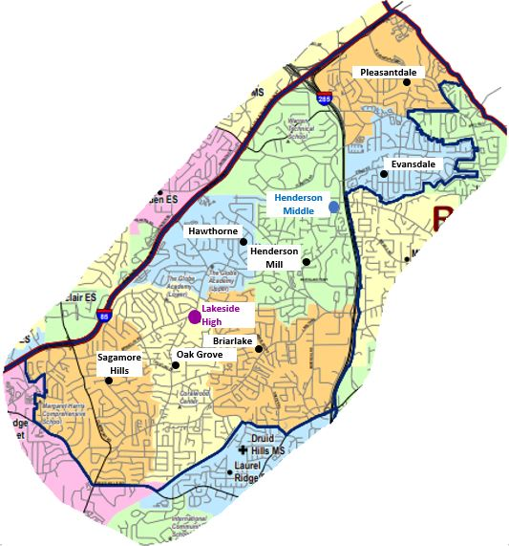
Getting Started in DeKalb Public School
Part 2: Getting Connected
Lakeside Cluster Summit
Notes:
Welcome to this video brought to you by the Lakeside Cluster Summit. This is the group of schools that belongs to the Henderson Middle and Lakeside High School attendance area.
Part 1 was about enrollment and registration. Part 2 is about getting connected.

Slide 2
Ways to Get Connected
Chromebook
Wifi hotspot/internet access
School Café account
Lakeside Cluster Summit
Notes:
We will explain several ways to get connected, including getting a Chromebook, access to wifi if needed, and a school café account. And there are several ways to stay informed, including Infinite Campus, sometimes called the Parent Portal, the school newsletter, and the PTA or PTSA social media. PTA means Parent Teacher Association, sometimes also called Parent Teacher Organization, in middle and high school it’s the Parent Teacher Student Association.

Slide 3
Technology Survey
Do you need access to the internet? Does your child need a Chromebook?
Complete this survey to describe your technology needs
https://forms.gle/YLEXNWL9ez2VMnnn9
DeKalb Schools are working to get wifi hotspots to eligible students who need internet access
Lakeside Cluster Summit

Slide 4
Chromebooks
Get access to a Chromebook if your child does not have one
Test to make sure it works
Test student account login
Note: Your child does not need to use a Chromebook for virtual learning. But they cannot bring their own device to school when in-person school is in session.
Lakeside Cluster Summit

Slide 5
Chromebook Access
All students can receive a Chromebook computer
Complete a user agreement online (English)
https://www.dekalbschoolsga.org/digital-dreamers/
Click here for a list of forms in other languages
Lakeside Cluster Summit

Slide 6
Chromebook Distribution
Contact your school about pickup times
Lakeside High School
Henderson Middle School
Briarlake Elementary School
Evansdale Elementary School
Hawthorne Elementary School
Henderson Mill Elementary School
Oak Grove Elementary School
Pleasantdale Elementary School
Sagamore Hills Elementary School
Lakeside Cluster Summit

Slide 7
Chromebook Test
If the computer does not start
Request assistance here https://www.dekalbschoolsga.org/digital-dreamers/get-assistance/
If something is missing or broken
Order a replacement here
https://appserver.virtucom.com/bga/dekalbaccessory.aspx
Lakeside Cluster Summit

Slide 8
Chromebook Access Test
Students need to test their Chromebook
https://www.dekalbschoolsga.org/virtual-learning-support/
If there are problems with the computer or accessing the student account
Request assistance here https://www.dekalbschoolsga.org/digital-dreamers/get-assistance/
Lakeside Cluster Summit

Slide 9
School Café Account
Overview: School nutrition website
https://www.dekalbschoolsga.org/school-nutrition/
Prepay for your child’s school lunch when school is open
Receive food deliveries when schools are virtual
Use School Café to apply for free or reduced lunch delivery
Currently receiving free or reduced lunch? Reapply in October
Lakeside Cluster Summit

Slide 10
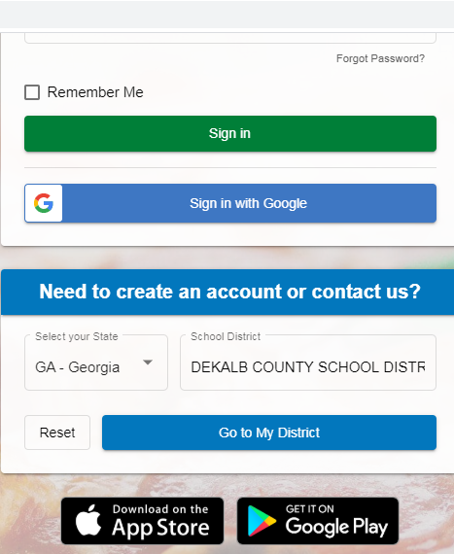
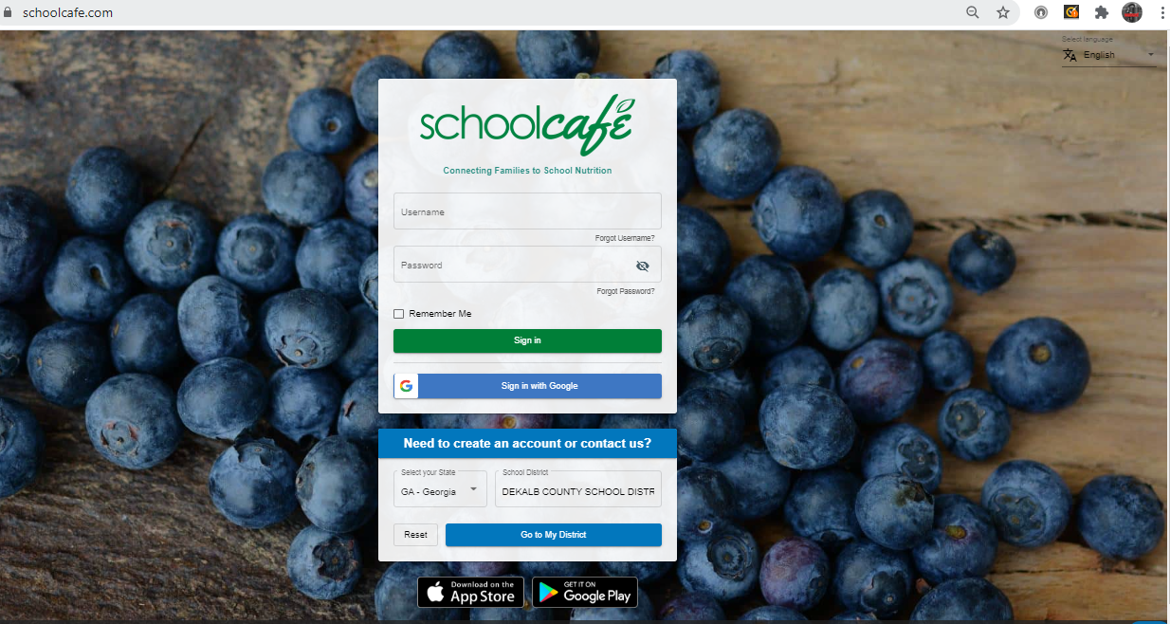
School Café Account: Enrolment
Go to https://www.schoolcafe.com/
Create your account
Available in several languages
You can download an app to your phone
Lakeside Cluster Summit

Slide 11
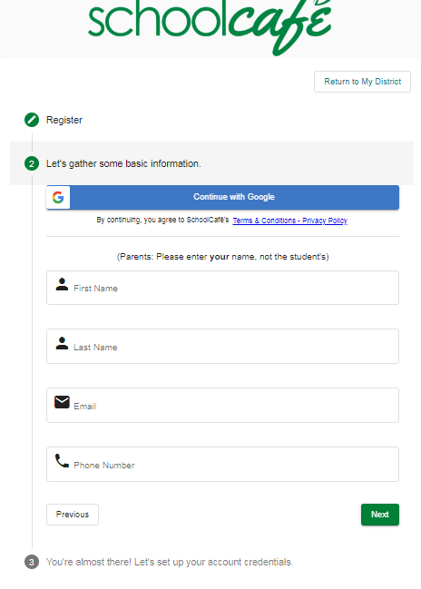
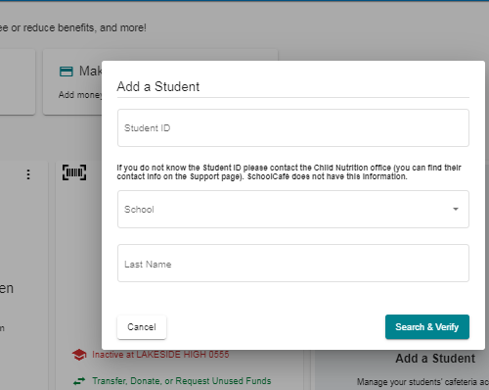
School Café Account Setup
For setup, you need:
Student ID
Email and phone number
Lakeside Cluster Summit

Slide 12
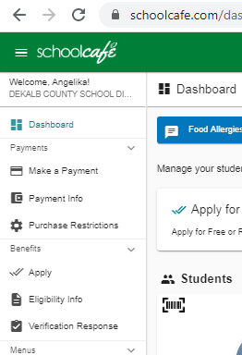
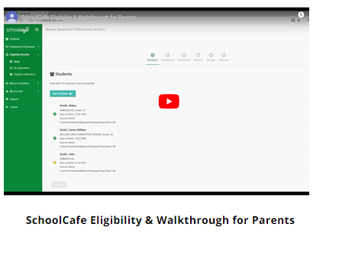
School Café Free or Reduced Lunch Application
Review the information about how to apply
https://www.dekalbschoolsga.org/school-nutrition/fr-meal-applications/
Watch a video tutorial
Click here to start the application
Lakeside Cluster Summit
Notes:
There are 3 steps you take to register your child at your school.
First is enrolling your child in the DeKalb County School System.
Next is registering your child at the school they will attend
Next is confirming registration.
Enrollment is for new students, registration is for students who change schools, and confirming registration happens every year

Slide 13
End of Part 2. We hope this was helpful. Also check out:
Part 1: Enrollment and Registration
Part 3: Staying Informed
This presentation was brought to you by the Lakeside Cluster Summit Communications Committee. We are a volunteer organization helping parents in our Henderson Middle and Lakeside High cluster of schools. Learn more at https://lakesidecluster.weebly.com/
Lakeside Cluster Summit
Notes:
End of Part 2. We hope this was helpful. This presentation was brought to you by the Lakeside Cluster Summit Communications Committee We are a volunteer organization helping parents in our Henderson Middle and Lakeside High cluster of schools. Learn more at https://lakesidecluster.weebly.com/

